Slide 1
EXCRETION
It is the removal of nitrogenous waste products from the body to regulate the composition of body fluids and tissues.
Handles osmoregulation:
○regulates the body’s salt and water content
It is not removal of undigested material (Egestion – removal of undigested food matter )

Slide 2

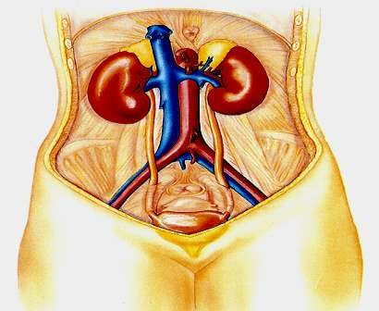
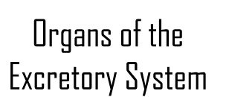
The human excretory system functions to remove waste from the human body.
During this process animals get rid of nitrogenous waste products of metabolism, including ammonia, urea, and uric acid.
Although excretory systems are diverse, nearly all produce urine in a process that involves several steps.
Kidneys
Urethras
Urinary bladder
Urethra

Slide 3
PROCESSES INVOLVED IN EXCRETION AND OSMOREGULATION
1. Ultra Filtration:
It is a process which separates the small molecules and ions from the large molecules and cells present in the blood or tissue fluid on the basis of their differential abilities to pass through the pores in a membrane
Reabsorption:
  It is the selective uptake from the ultrafiltrate of solute molecules and water in amounts necessary for the body.
Secretion:
  Other substances are extracted from body fluids and added to the contents of the excretory tube.
Excretion:
  The filtrate leaves the system and the body.

Slide 4
Excretory Organs
Kidneys are primary or major excretory organs in man and other vertebrtaes.
Some other organs such as lungs, liver, intestine and skin also remove certain metabolic wastes besides their normal function

Slide 5
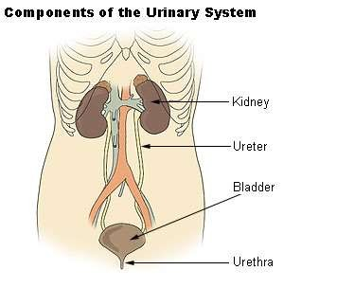
PARTS OF URINARY SYSTEM
A pair of Kidneys
A pair of Ureters
Bladder
Urethra

Slide 6
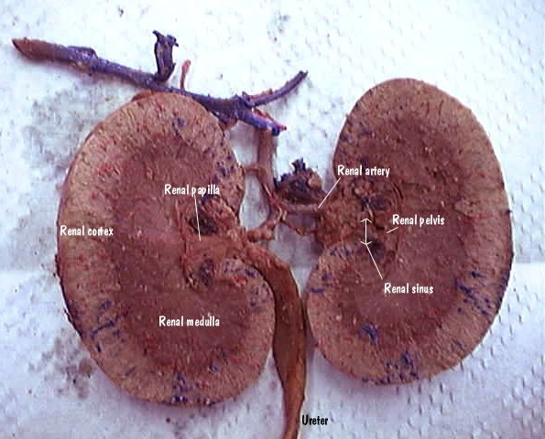
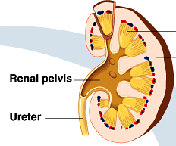


A pair of kidneys is located on both sides of the spine between thoracic and lumbar vertebrae.
Kidneys are dark red, bean shapedorgans
Weighing about 150 gm in adult male and 135 gm in adult female

Slide 7
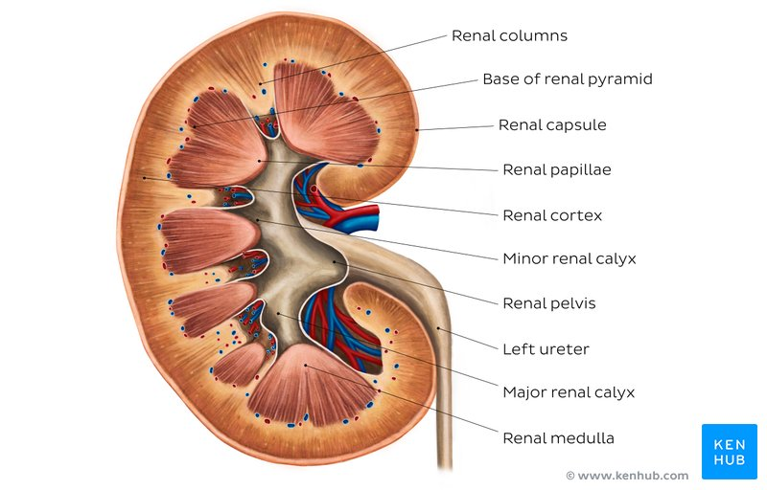
Internal kidney structure

Slide 8


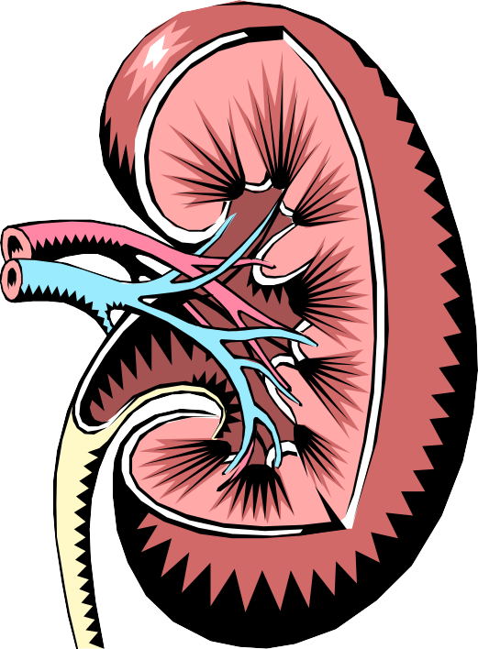
Parts of the kidneys
Kidneys filter about 1700 liters of blood daily in the average adult.
Medulla
Cortex
-outer protective portion
Medulla
-inner soft portion
Hilum
Hilum
-a depression located in the middle of the
concave side of the kidney where blood vessels, nerves, and the ureters enter and exit the kidneys
The cortex is where the blood is filtered.
Cortex
The medulla contains the collecting ducts which carry filtrate (filtered substances) to the pelvis.
The pelvis is a hollow cavity where urine accumulates and drains into the ureter.

Slide 9

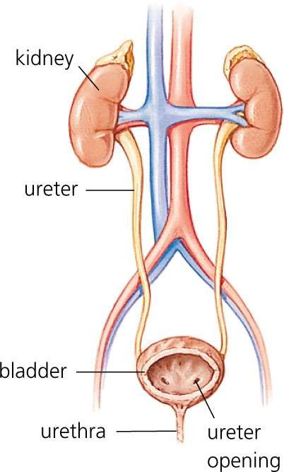

A tube approximately 6 to 7 inches long attached to each kidney.
Made up of three layers of tissue
  Smooth muscle
  Fibrous tissue
  Mucous layer
Ureter
Peristalsis, a rhythmic contraction of the ureter smooth muscle which helps to move the urine into the bladder.

Slide 10
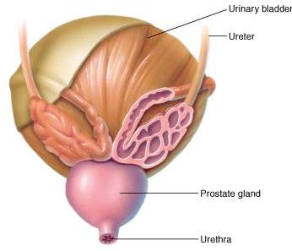
Urinary Bladder
Hollow, muscular organ that stores urine
Sphincter muscles hold the urine in place
Holds 300 to 400 milliliters of
urine before emptying
Walls contain epithelial tissue that stretch to allow the bladder to hold twice its capacity
Urinary bladder
Ureter
The trigone is a triangular area at the base of the bladder where the ureters enter and the urethra exits
Prostate gland
Urethra

Slide 11






Urethra
A tube of smooth muscle with a mucous lining that carries urine from the bladder to the outside of the body.
Female Urethra
Male Urethra
Approximately 1.5 inches long
Opens through the
meatus
Approximately 8 inches long
Passes through three different regions:
  Prostate gland
  Membranous portion
  Penis

Slide 12

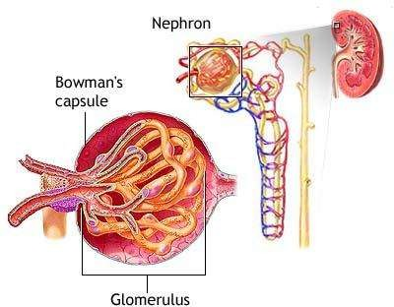
NEPHRON
The structural and functional units of the kidney are called nephrons. Kidney contains about a million nephrons
Nephrons are located in the renal cortex, except for their loops of Henle, which descend into the renal medulla.

Slide 13
NEPHRON
Two parts
Renal Corpuscle
  Bowman Capsule
  Glomerulus
  Together these form a globular body called renal corpuscle or malphigian body
    Fenestrae - pore in endothelial walls of glomerulus.
    Podocytes - specialized cells.
Renal Tubule - Series of single layer tubules
  Proximal Convoluted tubule (PCT)
  Loop of Henle
  Distal Convoluted tubule (DCT)
Kidneys are made up of nephrons. Blood enters the nephron, where impurities are filtered out and emptied into the collecting duct. The purified blood leaves the nephron through the renal vein.

Slide 14
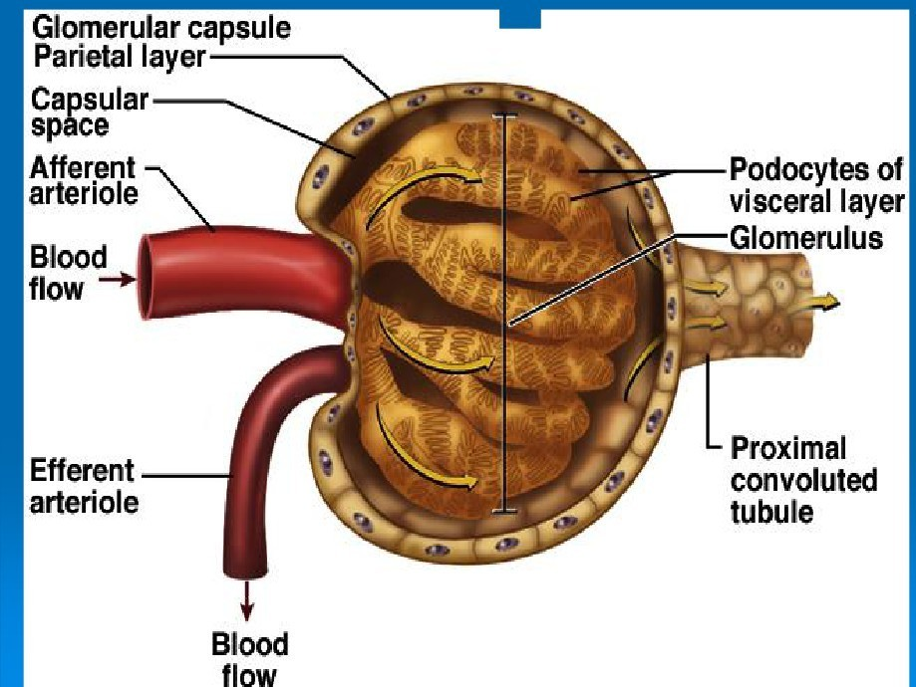

Slide 15
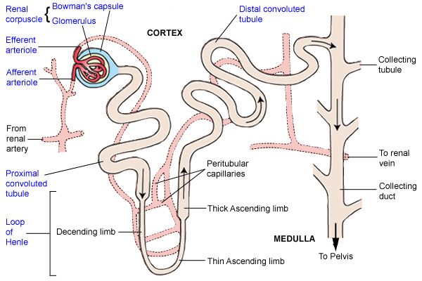

Slide 16
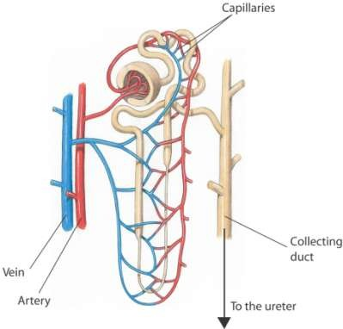
The glomerulus is a mass of thin-walled capillaries.
The Bowman’s capsule is a double-walled, cup-shaped
structure.
The proximal tubule leads from the Bowman’s capsule to the Loop of Henle.
The loop of Henle is a long loop which extends into the medulla.
The distal tubule connects the loop of Henle to the collecting duct.
  Each nephron has its own blood
supply:
    An arteriole
    A venule
    A network of capillaries
connecting them
Each nephron releases fluids to a collecting duct, which
leads to the ureter.

Slide 17
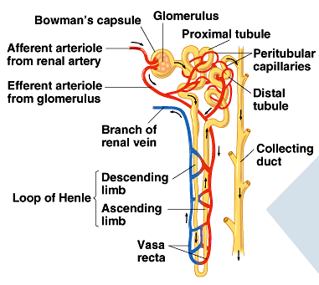
Blood Flow in Nephron
○Renal artery
○Afferent arteriole
○Capillaries of glomerulus
○Efferent arteriole
○Peritubular capillaries
○Vasa recta
○Renal vein

Slide 18
